Slide 1
Spring Expert Program
Notes:
JET-WAVE - Java Enterprise Technology based Web Architecture Visualization & Engineering
LEAP-FAST – League for Experts, Architects and Professionals - Foundation Academy for Software & Technology
brings to you dual specialization expert programs that goes beyond learning and focuses on ability development
EAP – Expert & Architect Program for Java & Web
RAISE – Rigor and Agility In Software Engineering
U-CARE – User-Centric Approach and Requirements Engineering
JWALA - Java and Web technology Architecture - Learning & Application
SUPER – Specialization in Usability and Performance Engineering Rigor

Slide 2
Objective
A comprehensive programme which focusses on building abilities to using Spring Framework
in solutioning / developing an enterprise application. The programme has been designed wherein
the participants will learn about the key features offered by the framework along with a
presentation and discussion of real project case studies by technology experts, who would share
the solutioning aspect and best practices..

Slide 3
Map
Apply abilities In context using tools and techniques, proposing right solution blocks , laying out processes to achieve project goals.
Associates
Role
( Designer and Senior Developer)
Abilities
Plan
Requires
Using
Provides
Tools & Techniques
Services
Adopting
Assure
Activities on
Process
Aligned to
On
Solution Blocks
Comprises
of
Solution
Context
That has
Qualified &
Quantified
Quality of Services
Measures

Slide 4
Key Learning Objectives
Newly Gained Abilities
Concepts
Define Solution Architecture
Using Spring Framework
Using Batch framework
Define user and system Interface
Define standards and guidelines
Integration with other frameworks.
Spring
Expert Program
Focus
Context
Process
Monitoring and Control
Project health monitoring (JMX)
Troubleshooting and triage
Test Automation
Continuous Integration
Plan Reuse
Tools & Techniques
Solution Blocks
Implementation Governance
Adherence to design principles
Adherence to best practices guidelines
Conducting technical reviews
Quality
Knowledge
Technical Solutioning for proposal
Formulating Q&A
Write-up
Prototyping techniques

Slide 5

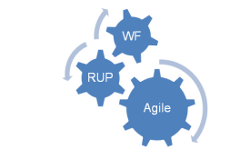

Key Learning Objectives
Context
Process
Tools & Techniques
Business Context
B2B
B2C
B2E
Process
Application Development – WF, RUP, Agile
Maintenance
Support
Migration
Upgrade
Re engineering
RIA
Product Quality Engineering
Service Orientation
Modernization
Development and Testing
Static Analysis
Test Driven Development
Functional Test Automation / Regression
Debugging
Continuous Integration
Architecture/Solution Context
Legacy Integration
Distributed / Federated Apps
Batch Frameworks
SOA
Deployment
Build Management
Notes:
ATDD – Acceptance Test Driven Development, BTDD – Behavior test driven development

Slide 6



Key Learning Objectives
Concept
Knowledge Areas
Solution Blocks
Architecture
Design Patterns
Persistence
Security
Cross Cutting (AOP)
Spring Framework
Java EE
Open Source
Presentation Tier – Integration with Struts, JSF and Spring MVC
Business Tier – Spring Core, Spring Batch, Spring Hibernate
Integration Tier -Synchronous and asynchronous communications, web services
Infrastructure Tier – Security, Logging , Resource Injection, configuration
Presentation
Spring MVC Framework
Quality
Integration
Web Services
REST
Spring Integration
Quality Attributes
Portability
Secured
Performance
Usability
Interoperability
Scalability
Reliability
Accessibility
Flexibility
Simplicity
Localization

Slide 7
Motivations !!!
  Comprehensive coverage of Spring Modules through workshops and preparatory sessions.
  KSS - Knowledge sharing based on experiences, best practices relevant to learning objective
  Working with demo’s and small example to understand the concepts and learn how to apply in real life projects.
  Creation of study circle to discuss various problem and solution encountered in day to day project.
  Assignment : Use Case Implementations using Spring
  Discussion on Real Case Studies

Slide 8
Participant Pre-requisites
Nominations in Teams of 3 or 4 associates – all from same location
  10 to 12 teams
Experience
  4 yrs of Java / JEE project development experience
  Min 6 months experience in Spring
Competency held in
  Java 5 (E1), Unit Testing (E0), JDBC (E0), Hibernate ORM (E0), Maven (E0)
  Completed all pre-requisite WBT
Commitment to :
  Spent 60 contact hours (in span of 1 month)
  Own and share knowledge and opinion on certain voluntary topics from the shared reading lists
  Participate in all team activities and workshops
  Share results of application of learning - in pre-identified anchor engagements

Slide 9
Assessments & Rewards
Overall Assessment Criteria - Post Program
  Assignment evaluation - Completion of Use Cases and Applied Knowledge for proper understanding.
  Presentation – Associates need to give a presentation on their learning during the course and any contribution they have made towards enhancing their current project.
  Exit test - Brainbench or CAS 3.0 Score.
  Community Contribution - Contribute to Spring Program for next session
  Rewards - Top 10% could be nominated ( on approval of CDM) for spring source certification

Slide 10
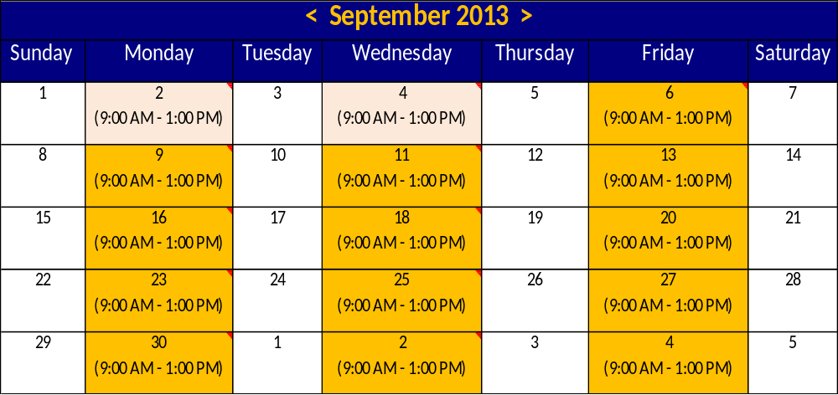
Engagements & Schedules
Program Date: 2nd Sep – 3rd October (9 AM – 1:00 PM)
Venue: Pioneer Bangalore
Workshops with Labs & Assignments
Preparatory session with Labs

Slide 11
Roles & Responsibilities
L&D
  Publish Program
  Invite Nominations
  organize participants in study circles
  organize course and video-con session
  Track completion of competency update for participants in iCALMS
  Track Progress and status of Program
  Review Feedback
TEG
  Nominate participants from respective Units (OU)
  Identify SME as faculty and assessor
  Track SME Assessment
Participants
  Developers, Designers, Tech Lead, Architects
Responsibilites
  Complete Nomination Formalities
  Complete the pre-requisites
  Participate in the sessions
  Complete the final assessment

Slide 12
Thank You

Slide 13
Appendix

Slide 14
Spring Core Fundamentals
Course Description : Boot Camp
  At the end of the program, you should have an understanding of Spring and associated technologies and be able to do the following:
  Use the Spring Framework to develop Java applications
  Use dependency injection to set up and configure applications
  Test Spring-based applications
  Set up Spring configuration using XML, annotations, and Java configuration
  Use Hibernate and JDBC with Spring to access relational databases
  Use Spring support for transactions
  Use aspect-oriented programming (AOP) to add behavior to objects
  Develop a basic Web application with Spring MVC
  Integrate Spring with JSF and Struts.
  Use Spring Security to secure Web applications
  Use JMX for monitoring and control **
  Use JMS for application auditing.**
  Apply Spring Batch to simple use case**

